Slide 1
Event Recognition in EEG Data
Presenter: Kate Pabst

Slide 2
In This Presentation
Motivation
Problem Statement
Data
Method
Implementation & Results
Future Work
Summary
Motivation
Problem
Data
Method
Implementation & Results
Future Work
Summary

Slide 3
Motivation
EEG (Electroencephalography) refers to the recording of electrical activity along the scalp
EEG has been in use many years in laboratory settings
First use in human subject in 1924
Used to study problems in variety of fields (cognitive science, psychology, etcetera)
In recent years, technology companies have begun offering simpler and cheaper EEG systems to consumers
First basic model ~ 11 years ago for $20,000
Now, several companies offer models from $50-$800
Increased availability of technology is leading to growing interest in developing algorithms for use both academic, commercial, and personal
Motivation
Problem
Data
Method
Implementation & Results
Future Work
Summary

Slide 4
Motivation
Company InteraXon began shipping Muse headband April 2014
4 channels (rather than 19 used in laboratory settings)
Users may use standard application (Calm) to monitor brainwaves, or create their own applications using the developers kit provided
This project begins to explore methods by which the EEG data from Muse can be used to predict a state of the wearer
A model to recognize an EEG pattern may be used in many ways
Recognize a reaction to stimuli, filter out noise, etcetera
Begin with eye movement (easy & inexpensive experiment to set up)
Motivation
Problem
Data
Method
Implementation & Results
Future Work
Summary

Slide 5
Problem
Data available = electrical activity (in microvolts) from 4 channels
Using the available signals, build a model which predicts eye movement (right, left, or not looking)
Requirements for model
Algorithms must be fast enough to predict in real time
Reasonable rates of misclassification
Motivation
Problem
Data
Method
Implementation & Results
Future Work
Summary

Slide 6
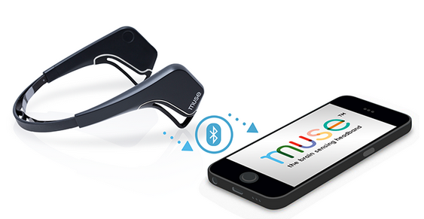
Data – Equipment
Muse headband has 7 sensors (2 behind ears, 2 on forehead, 3 reference)
Channel 1: Left ear
Channel 2: Left forehead
Channel 3: Right forehead
Channel 4: Right ear
Headband sends data via
Bluetooth at 220 Hz
Due to buffering, dropped packets, etcetera data does not come in at standard time units
Motivation
Problem
Data
Method
Implementation & Results
Future Work
Summary

Slide 7
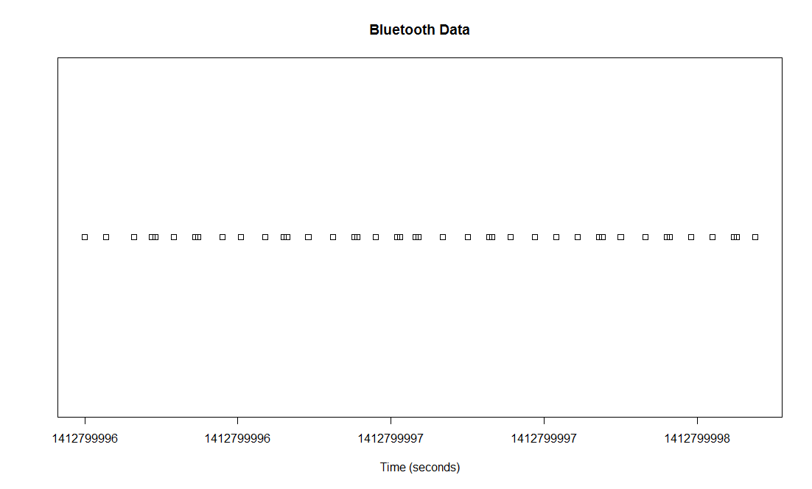



Data – Data Standardization
Data comes at irregular time intervals
At each standard time unit (.1 second), the 5 nearest neighbors are averaged to form the sensor value
where y_{j} are nearest values on time line
Source of error – Physical limitations of system mean values at standard time units must be approximated
$${Sensor}_{i}=\frac{\sum_{j=1}^{j=5}{y_{j}}}{5}$$
Motivation
Problem
Data
Method
Implementation & Results
Future Work
Summary

Slide 8


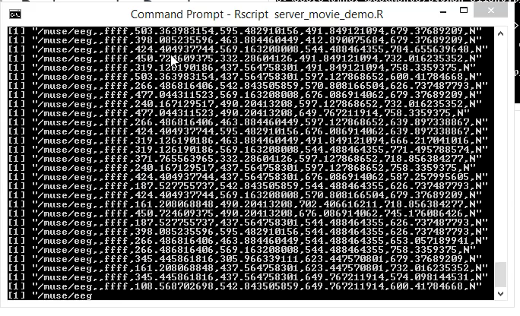
Data – Data Input (Client/Server Solution)
Goal: Make real time predictions on eye movement while wearing headband
However, R environment does not provide much support for streaming data real time from Bluetooth
Solution: Python acts as client & R acts as server on same machine
Python script (client): Reads sensor data from UDP port, decodes it into understandable format, sends to “server” over UDP port
Rscript script (server): Reads UDP port from client, gets data, performs analysis using R libraries
Source of error – Time lag between measurement occurring and
R reading data from second UDP port can cause measurement error
Motivation
Problem
Data
Method
Implementation & Results
Future Work
Summary

Slide 9
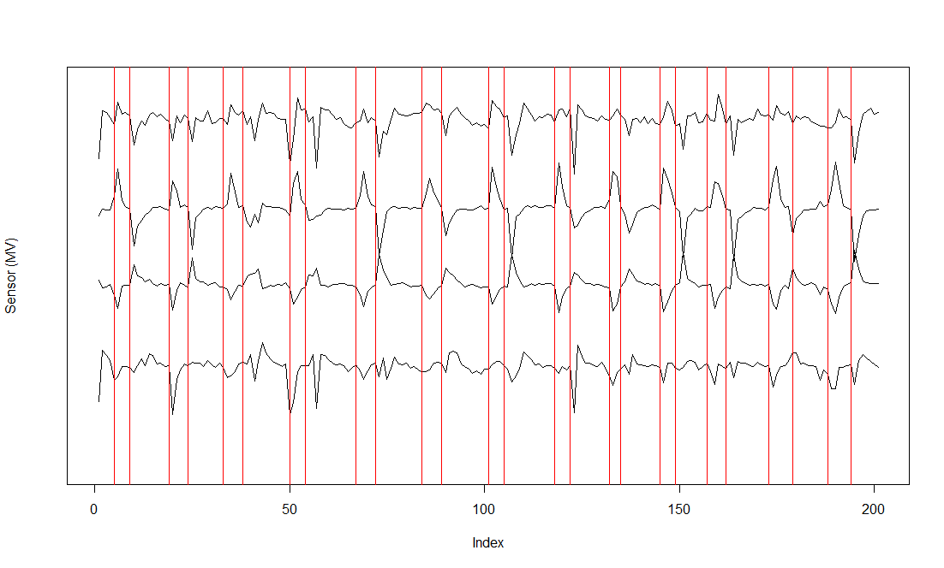
Data – Data Collection
Python/R scripts written to capture events (eye movements) of user while wearing headband
Subject uses keyboard shortcuts to tell program when they are starting/stopping eye movement
Data from 4 sensors recorded for each time unit and assigned an event
Training
Event | Left/Right Dataset | Event | Up/Down Dataset
Right | 66 events | Up | 65 events
Left | 70 events | Down | 72 events
Neutral | 137 events | Neutral | 139 events
Testing
Event | Left/Right Dataset | Event | Up/Down Dataset
Right | 66 events | Up | 96 events
Left | 74 events | Down | 103 events
Neutral | 141 events | Neutral | 203 events
Example: Event for S1 captured between red lines
Source of error – Time lags between user making movement and user inputting keystroke can cause measurement error
Motivation
Problem
Data
Method
Implementation & Results
Future Work
Summary

Slide 10
Method – LDA Approach Overview
At each standard time unit, find # of extreme points (peaks/valleys) during the last user defined time window
Feed # of peaks/valleys in time window into prediction algorithm (LDA)
LDA returns a posterior probability of each class. For example, in left/right problem
If probability > left threshold choose left class
If probability > right threshold choose right class
Otherwise, choose neutral
Motivation
Problem
Data
Method
Implementation & Results
Future Work
Summary

Slide 11
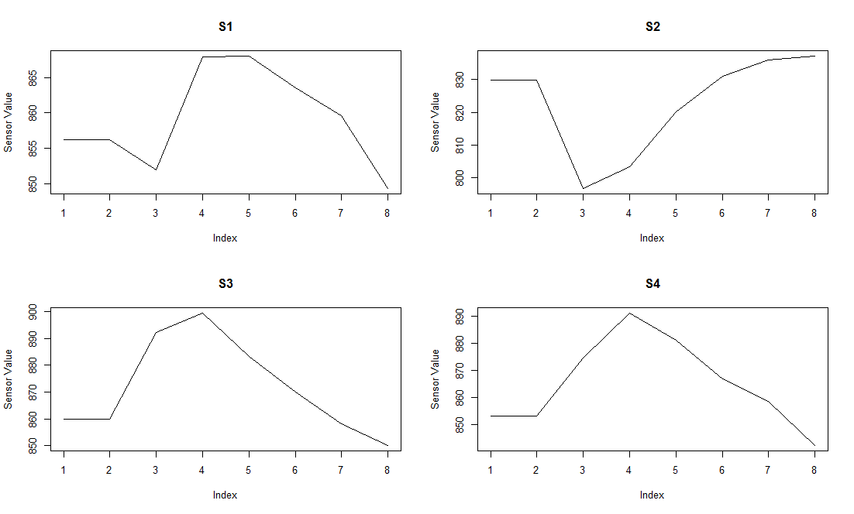
Method – LDA Approach: Peaks/Valleys in Time Series
Each movement is characterized by variations in time series that are predictable in direction (if not scale)
Example – Typical right event (shown here) is characterized by valley in S2 & peaks in S3/S4. S1 is not a good predictor of a right event.
Table: Characteristic patterns for each event
(subjective interpretation)
Not all sensors are good predictors for all events
What is characteristic pattern for an event can be subjective
Action | S1 | S2 | S3 | S4
Up | Valley | Valley | Peak | Valley
Down | None | Peak | Peak | None
Left | None | Peak | Valley | None
Right | None | Valley | Peak | Peak
Motivation
Problem
Data
Method
Implementation & Results
Future Work
Summary

Slide 12
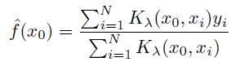
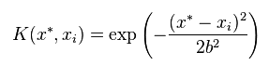
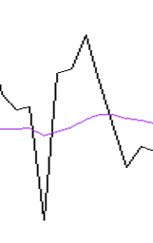
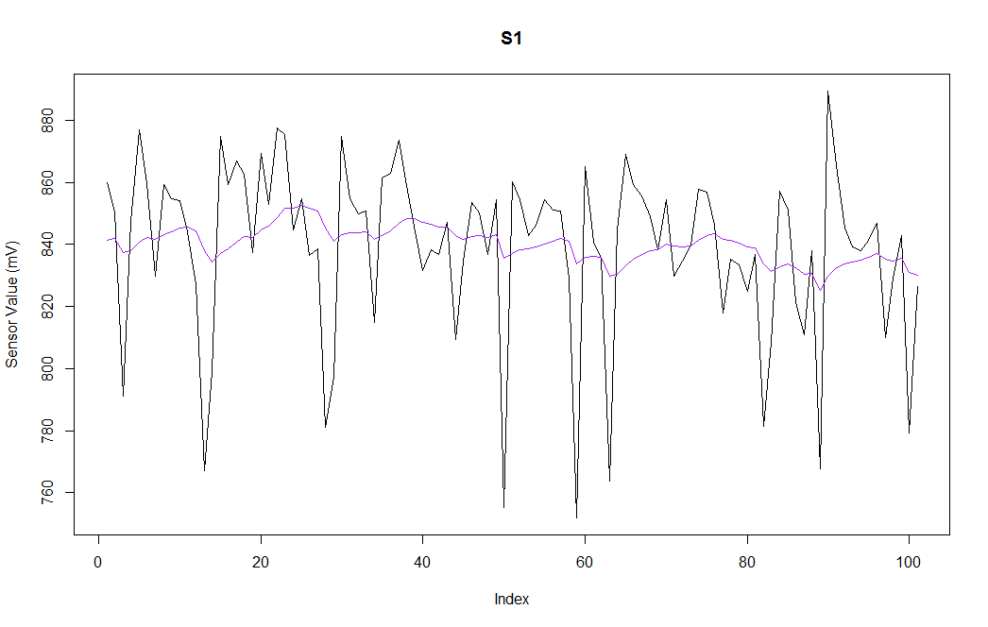
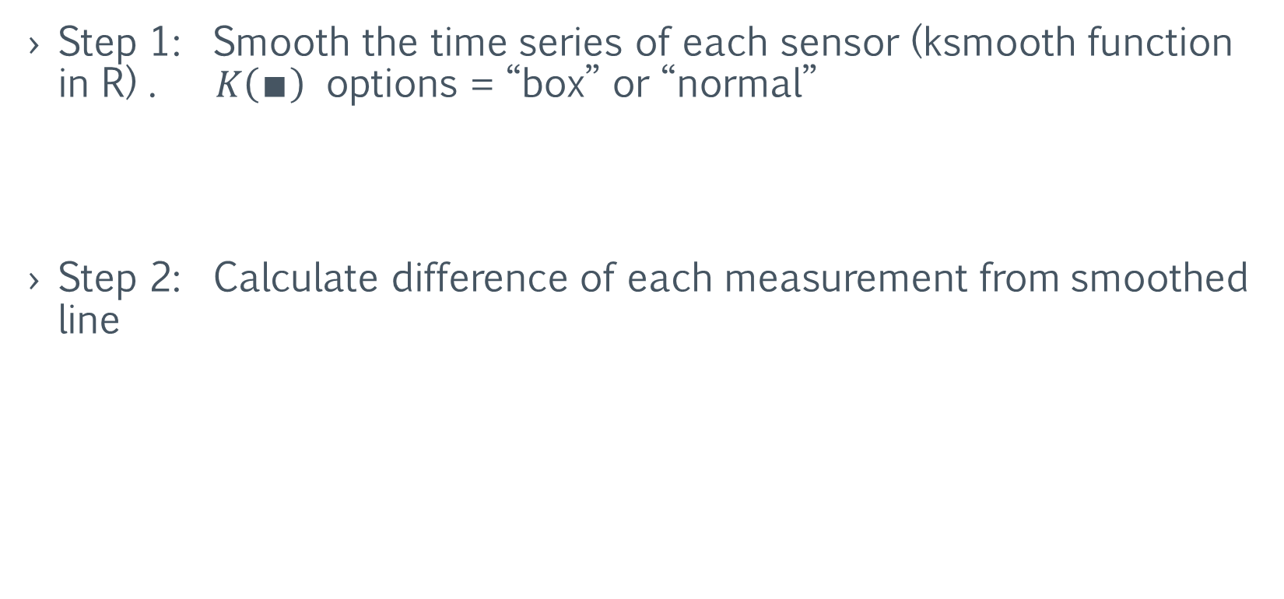
Method – LDA Approach: Peaks/Valleys Identification
Step 1: Smooth the time series of each sensor (ksmooth function in R) . $K\left(∎\right)$ options = “box” or “normal”
Step 2: Calculate difference of each measurement from smoothed line
D_{i} = X_{i} – XSmoothed_{i}
OR
D_{i} = (Black line @ i) – (Purple line @ i)
i
Motivation
Problem
Data
Method
Implementation & Results
Future Work
Summary

Slide 13
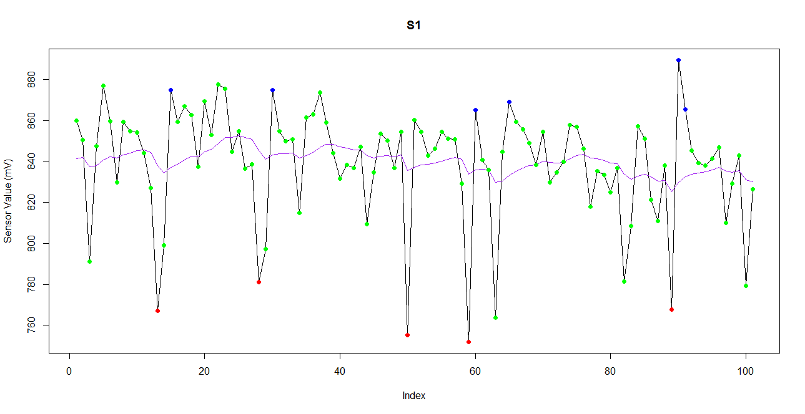
Method – LDA Approach: Peaks/Valleys Identification
Step 3: Calculate upper & lower quantiles of last Y data points
For this model, use 25 last data points
For this example, upper quantile = .95 & lower quantile = .05
Step 4: Determine if peak or valley
If difference at time > upper quantile then time series is in a peak
If difference at time < lower quantile then time series is in a valley
Blue points = peak
red points = valley
Motivation
Problem
Data
Method
Implementation & Results
Future Work
Summary

Slide 14
Method – LDA Approach: Data Example
Time | Action | # Peaks S1 | # Valleys S1 | # Peaks S2 | # Valleys S2 | # Peaks S3 | # Valleys S3 | # Peaks S4 | # Valleys S4
0.1 | R | 0 | 1 | 0 | 0 | 2 | 0 | 0 | 0
0.2 | R | 0 | 2 | 1 | 0 | 1 | 0 | 0 | 1
0.3 | R | 0 | 2 | 1 | 1 | 0 | 0 | 0 | 1
0.4 | R | 0 | 2 | 2 | 1 | 0 | 0 | 0 | 0
Characteristic variables = the # of peaks and valley in the last 5 time periods
Training phase
Feed training dataset into lda function of R
Store resulting LDA model
Testing phase
Retrieve previously created LDA model
Use predict function of R (on LDA object) to get posterior probabilities for each new row of data
Motivation
Problem
Data
Method
Implementation & Results
Future Work
Summary

Slide 15
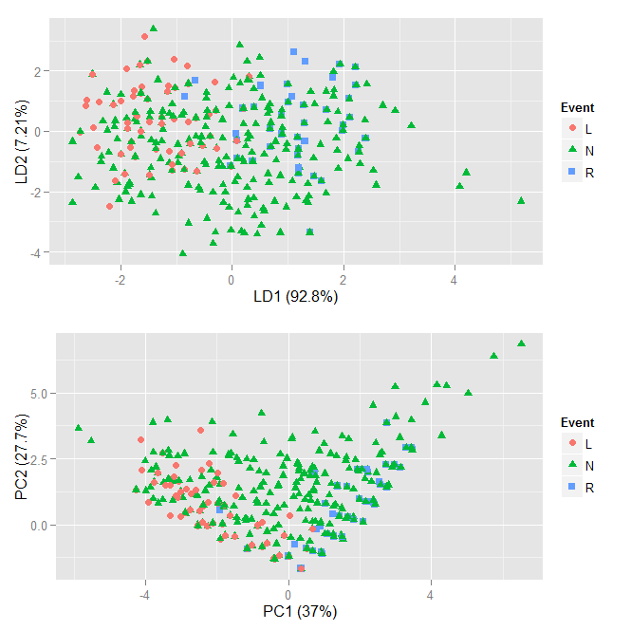
Method – LDA Approach: Need for Threshold Probabilities
Three classes in example problem:
Right movement
Left movement
Neutral (sitting still, fidgeting, blinking, looking straight, etcetera)
In up/down problem, these classes replace right/left
Neutral (doing nothing) applies to wide range of potential patterns and is thus harder to classify
Right/left events are fairly well separated in LDA/PCA space, but neutral events have significant overlap
Need algorithm to separate classes, keeping in mind difficulty neutral poses
LDA
PCA
Motivation
Problem
Data
Method
Implementation & Results
Future Work
Summary

Slide 16
Method – LDA Approach: New Predictions (Left/Right Example)
For each new time period: Use LDA model, control limits, time window, smoothing period set in training
Are all 4 sensors within the control limits?
Yes: Prediction neutral
No: Move to LDA model
Examine posterior probability of each class (left/right example)
Probability of left > user defined threshold? Predict left.
Probability of right > user defined threshold? Predict right.
Probability of neutral > user defined threshold OR failure to predict left or right? Predict neutral.
Motivation
Problem
Data
Method
Implementation & Results
Future Work
Summary

Slide 17
Method: Stretch Approach Overview
For each sensor, smooth time series using kernel smoothing
Apply transformation on difference (value @ time t – smoothed value @ time t) to exaggerate/understate features
Set control limits for difference (subjective, selected by user)
Over upper control limit = peak
Under lower control limit = valley
3. Set expected behavior (subjective, selected by user).
Example: “When a left event occurs, sensor 2 shows a peak and sensor 3 shows a valley.”
4. At each time period, predict event based on behavior
Example: “If at time 3.4 seconds sensor 2 is above control limit and sensor 3 is below control limit, predict left”
Motivation
Problem
Data
Method
Implementation & Results
Future Work
Summary

Slide 18
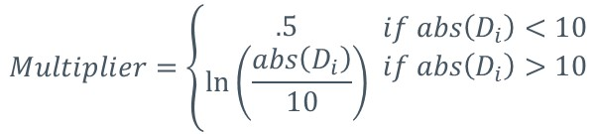
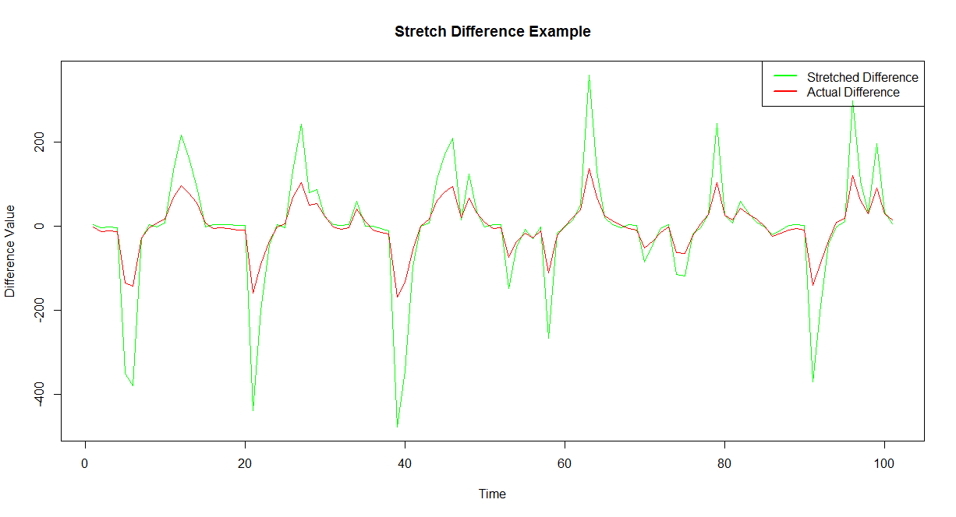
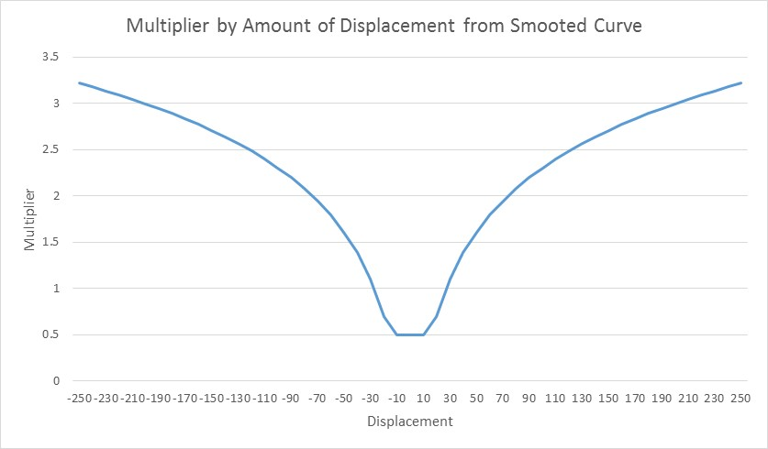
Method: Stretch Approach Transformation
Small variations of signal from smoothed curve most likely noise
Large variations of signal from smoothed curve likely to have been caused by an event (movement, head turn, etcetera)
Want to exaggerate features when displacement is above what is generally considered noise, minimize features when displacement is considered noise
Displacements greater than ~ 13.6 will be amplified, less than ~ 13.6 will be dampened
Green line = actual difference X multiplier
Motivation
Problem
Data
Method
Implementation & Results
Future Work
Summary

Slide 19
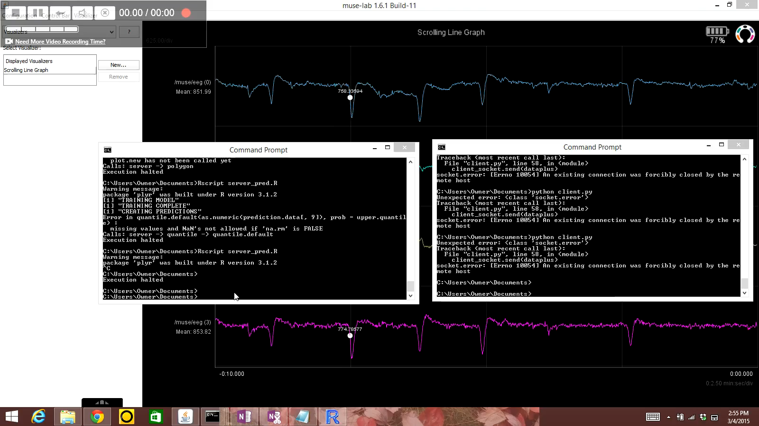


Implementation - LDA Demonstration
Motivation
Problem
Data
Method
Implementation & Results
Future Work
Summary

Slide 20
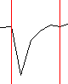
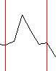
Implementation – Evaluation criteria
Evidence for event may not be strong during all time units of event
Errors calculated on event level, not on time unit level
In example above, time unit level would compare predictions vs. actual for each of 4 units of .1 seconds (black lines)
Event level would compare predictions vs. actual for the entire event (red lines)
Error calculations
% of time right/left event correctly identified (neutral classification at beginning/end of event allowed)
% of time right/left event incorrectly identified
% of time right/left event correctly and incorrectly identified (2 or more different predictions within event)
% of time right/left event not identified as a movement (cannot distinguish from doing nothing)
% of time stamps doing nothing is correctly identified
Valley for S2 evident here
But not here
Peak for S3 evident here
Or here
But not here
Motivation
Problem
Data
Method
Implementation & Results
Future Work
Summary

Slide 21
Results – Model Results
LDA (see parameters) |  |  |  |  | Stretch (see parameters)
Event | % Correct Only | % Incorrect Only | % Correct & Incorrect | % Not Recognized As Movement | Event | % Correct Only | % Incorrect Only | % Correct & Incorrect | % Not Recognized As Movement
Right | .97 | 0 | 0 | .03 | Right | .95 | 0 | .02 | .03
Left | .96 | 0 | .01 | .03 | Left | .99 | 0 | .02 | 0
Up | .88 | .02 | .01 | .09 | Up | .92 | 0 | .06 | .02
Down | .83 | .08 | 0 | .09 | Down | .79 | 0 | .1 | .11
Model | Problem | % Correct Neutral Time Stamps
LDA | Right/Left | .75
LDA | Up/Down | .81
Stretch | Right/Left | .86
Stretch | Up/Down | .76
Neutral time stamp errors driven mostly by “return to center” behavior (what is this?)
SFD
Motivation
Problem
Data
Method
Implementation & Results
Future Work
Summary

Slide 22
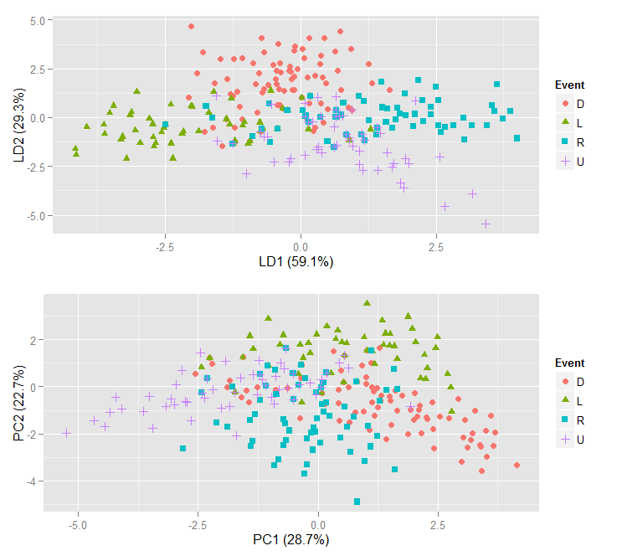
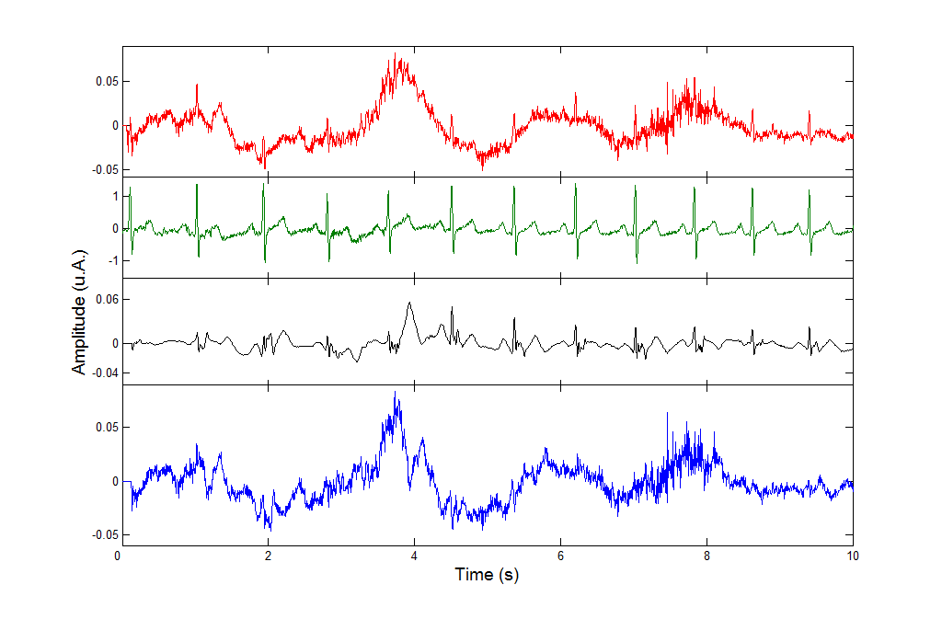
Future Work
Develop more robust measurement systems to reduce amount of error
Incorporate more classes into model (a more difficult problem)
Apply this or similar methods to more general Event Related Potentials (ERP)
Patterns can be caused by any number of studied stimuli
Motivation
Problem
Data
Method
Implementation & Results
Future Work
Summary

Slide 23
Summary
As technology becomes cheaper and more widespread, methods for EEG analysis will be needed in wide array of applications
Methods for recognizing patterns applicable to many problems, not just recognizing eye movement
Proposed methods combine
Smoothing methods
Extreme point identification
Linear discriminant analysis
Non parametric algorithm
to create real time predictions
Motivation
Problem
Data
Method
Implementation & Results
Future Work
Summary

Slide 24
BACKEND SLIDES

Slide 25
Definitions
Reference sensor – Provides stable potential (voltage) against which measuring sensor can be measured
Hertz – Unit of frequency, equal to 1 cycle per second
Event Related Potential - The measured brain response that is the direct result of a specific sensory, cognitive, or motor event.

Slide 26
Files – Click to Open
client.py: Reads data on UDP port 5001 from Muse, translates data packages into useable (i.e. readable by other programs) format, sends decoded data to UDP port 5010. Python file.
server.R: Reads data from UDP port 5010, creates standard time units, performs nearest neighbor rounding, stores data (for training and testing) in csv file. Rscript file.
server_pred.R: Reads data from UDP port 5010, creates standard time units, performs nearest neighbor rounding, creates predictions, populates chart shown in demo. Rscript file.
Train model test model functions: Contains functions (suitable for copying and pasting into R environment) for training and testing models. Text file.
Training and testing datasets. Excel files.

Slide 27
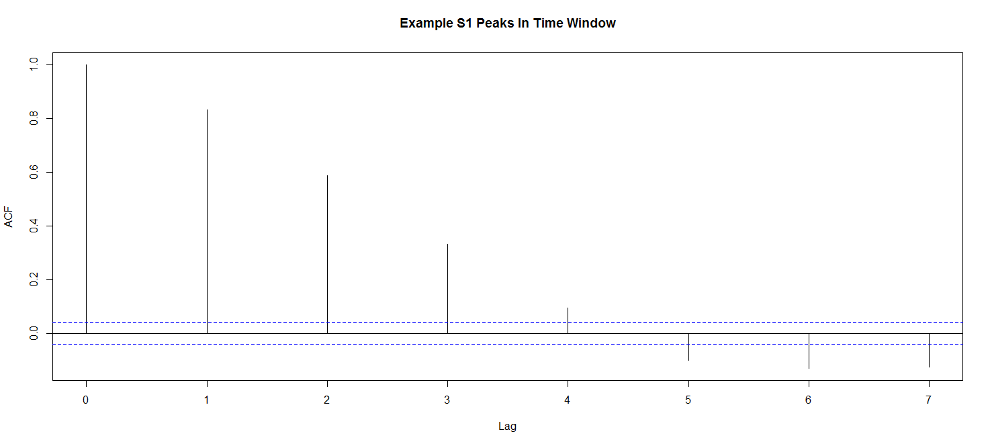
LDA Assumptions – Independent Subjects
Each row of data represents a standard time unit (.1 seconds, .2 seconds, .3 seconds, and so on)
Each column represents the number of peaks or valleys in a time window (here, .5 seconds) for each sensor
Subjects not independent because
Time points correlated with each other
Time window overlaps same rows in adjacent rows

Slide 28
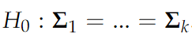
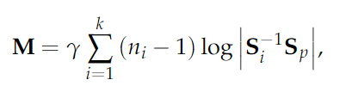
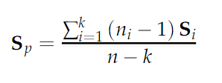
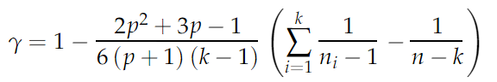
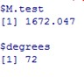
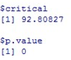
LDA Assumptions – Equivalence of covariance matrices (Box’s M Test)
Test
M follows chi-square with (1/2)(p+1)(k-1) degrees of freedom
where
Code taken from Tsagris, Michail, “Multivariate statistical functions in R”, http://www.academia.edu/1887808/
Reject equivalence (using attached function)

Slide 29
Final parameters
For LDA, parameters set after brute force optimization
Left/Right
Upper control limit = .9
Lower control limit = .1
Left threshold = .45
Right threshold = .45
Up/Down
Upper control limit = .9
Lower control limit = .1
Up threshold = .38
Down threshold = .3
For Stretch method, parameters set subjectively (after examining visual patterns by eye)
Left/Right
Upper control limit = 50
Lower control limit = -30
Up/Down
Upper control limit = 15
Lower control limit = -30

Slide 30
Neutral Error
During data collection, the user enters (via keycode) the stop and beginning of an eye movement. For example, a key is hit at the beginning of a left eye movement and at the end of the movement. However, it should be noted that generally a user will return to center after a movement. For example, after looking left the user will return their gaze to center. This involves moving the eye right to return to center. This return to center is still classified in the training/testing data as “N” (for neutral). A deeper analysis of the neutral error shows that virtually all of the errors occur when the return to center activity is taking place. Although many “neutrals” appear to be misclassified, it is probable that this is only due to actual directional movements not being captured in sufficient detail. See next slide for details.

Slide 31
Neutral Error (cont.)
Model | Problem | Incorrect Answer | # Incorrect Answers | # of Times Incorrect Answer Occurred Immediately After Opposite Movement
LDA | Right/Left | L | 200 | 200
LDA | Right/Left | R | 212 | 192
LDA | Up/Down | U | 320 | 302
LDA | Up/Down | D | 470 | 470
Stretch | Right/Left | L | 150 | 150
Stretch | Right/Left | R | 120 | 118
Stretch | Up/Down | U | 138 | 119
Stretch | Up/Down | D | 273 | 273

Slide 32
Origins of Eye Movement Voltage
No one answer accepted by all
3 common answers
Cornea is positively charged and retina negatively charged. When this dipole moves electric field around eye is changed, which reflects in scalp measurements
Similar to explanation above, but postulates that effect is mainly due to potential difference around the retina
Sliding of eyeballs across eyelids affects voltage around eyes

